Slide 1
Image Segmentation
Oran Nahum

Slide 2
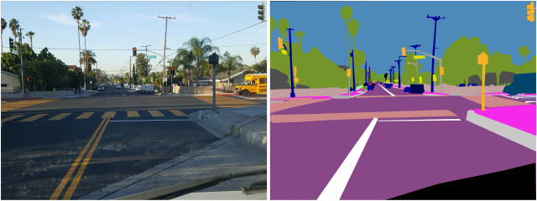
Image Segmentation
Problem defintion: where do the entities start and end in the image?

Slide 3
Image Segmentation
This is an image to image problem
Input shape=(w, h, 3)
Output shape=(w, h, num_classes)

Slide 4
Image Segmentation
In Image-to-image models, it is important to manage layer dimensions
(Notice it is always <= to original)
Conv2D
Kernel size=k
Stride=s
Filters=f
Padding=p
Output
shape=
(1 + (W - k + 2*p)/s,
1 + (H - k + 2*p)/s,
f)
Input
shape=
(W, H, c)

Slide 5
Image Segmentation
In Tensorflow, you can only pick padding=’same’ or padding=’valid’
padding=’same’:
W’ = W/s, H’ = H/s
padding=’valid’ (no padding):
W’ = 1 + (W - k)/s, H’ = 1 + (H - k)/s

Slide 6
Image Segmentation
There are many ways to reverse convolution - Transpose convolution is one of them
1 Conv2DTranspose reverses 1 convolution layer
Conv2DTranspose
Kernel size=k
Stride=s
Filters=f
Padding=p
Output (padding=’same’)
shape=
(W * s,
H * s,
f)
Input
shape=
(W, H, c)

